Slide 1
Optimizing Sequential Programs
Zizhong Chen
University of California, Riverside
chen@cs.ucr.edu

Slide 2
Principle of Locality
Principle of Locality: Programs tend to use data and instructions with addresses near or equal to those they have used recently
Temporal locality:
Recently referenced items are likely to be referenced again in the near future
Spatial locality:
Items with nearby addresses tend to be referenced close together in time

Slide 3
Locality Example
sum = 0;
for (i = 0; i < n; i++)
sum += a[i];
return sum;
Data references
Reference array elements in succession (stride-1 reference pattern).
Reference variable sum each iteration.
Instruction references
Reference instructions in sequence.
Cycle through loop repeatedly.
Spatial locality
Temporal locality
Spatial locality
Temporal locality

Slide 4
Memory Hierarchies
Some fundamental and enduring properties of hardware and software:
Fast storage technologies cost more per byte, have less capacity, and require more power (heat!).
The gap between CPU and main memory speed is widening.
Well-written programs tend to exhibit good locality.
These fundamental properties complement each other beautifully.
They suggest an approach for organizing memory and storage systems known as a memory hierarchy.

Slide 5
An Example Memory Hierarchy
L0:
CPU registers hold words retrieved from L1 cache
Registers
L1:
L1 cache
(SRAM)
Smaller,
faster,
costlier
per byte
L1 cache holds cache lines retrieved from L2 cache
L2:
L2 cache
(SRAM)
L2 cache holds cache lines retrieved from main memory
L3:
Larger,
slower,
cheaper
per byte
Main memory
(DRAM)
Main memory holds disk blocks retrieved from local disks
L4:
Local secondary storage
(local disks)
Local disks hold files retrieved from disks on remote network servers
Remote secondary storage
(tapes, distributed file systems, Web servers)
L5:

Slide 6
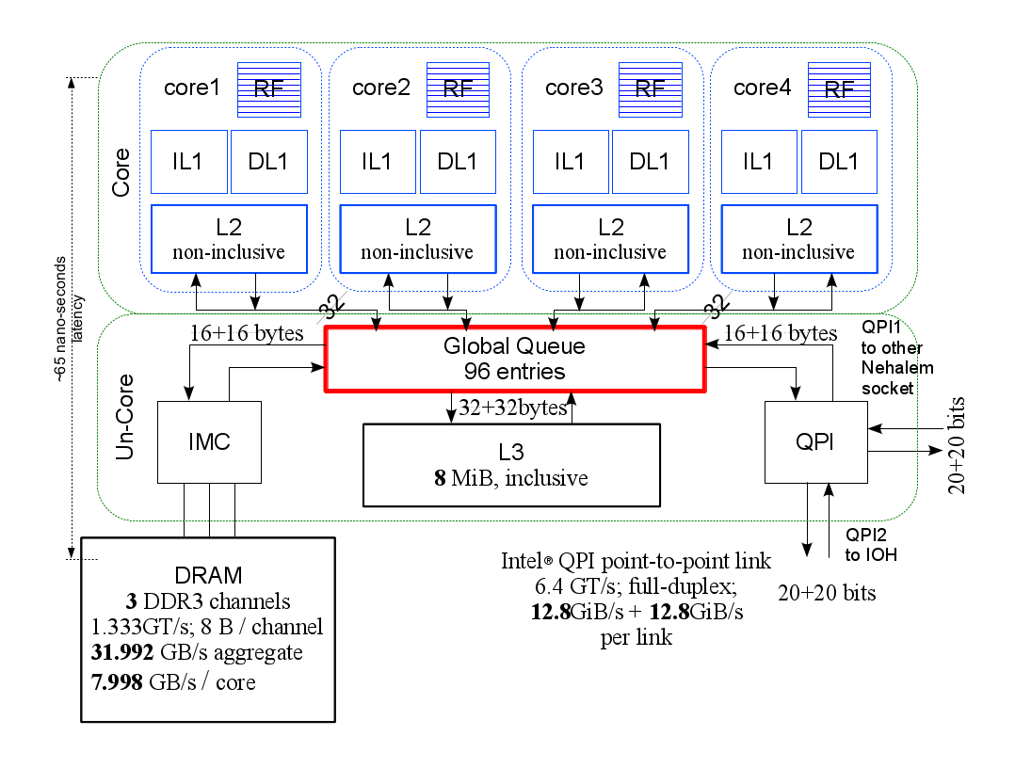
An Example: Intel Nehalem Core i-7
Rigester access, ~1 cycle
L1 Cache access, ~4 cycles
L2 Cache access, ~10 cycles
L3 Cache access, line unshared, ~40 cycles
L3 Cache access, shared line in another core, ~65 cycles
L3 Cache access, modified in another core, ~75 cycles
DRAM accesss, ~150 cycles
Disk access, ~10,000 cycles
CPU is very fast: 4 or 8 operations per cycle

Slide 7
Example: Matrix Multiply with Register Reuse
C = C + A * B
for ( i=0; i<n; i++ )
for ( j=0; j<n; j++ )
for ( k=0; k<n; k++ )
C[i*n+j]+=A[i*n+k]*B[k*n+j];
for ( i=0; i<n; i++ )
for ( j=0; j<n; j++ ) {
register double t=C[i*n+j];
for ( k=0; k<n; k++ )
t+=A[i*n+k]*B[k*n+j];
C[i*n+j]=t;
}

Slide 8
Example: Matrix Multiply with Register Reuse
for ( k=0; k<n; k++ )
C[i*n+j]+=A[i*n+k]*B[k*n+j];
LOOP: ldcl $s1, … load C[..] from memory to register
ldcl $t1, … load A[..] from memory to register
ldcl $ t2, … load B[..] from memory to register
mul.d $t3, $t1, $t2 multiply A[][] and B[][]
add.d $s1, $s1, $t3 update C[][] with C[][]+A[][]*B[][]
sdcl $s1, … store C[..] from register to memory
addi $t0, $t0, 1 increase loop index k by 1
slt $t3, $t0, $s0 judge if k<n or not
bne $t3, $0. LOOP go to the next iteration if k<n
The inner iteration has 3 loads from memory and 1 store to memory. Moving data from memory to register is much much slower than arithmetic calculations!

Slide 9
Example: Matrix Multiply with Register Reuse
register double t=C[i*n+j];
for ( k=0; k<n; k++ )
t+=A[i*n+k]*B[k*n+j];
C[i*n+j]=t;
ldcl $s1, … load C[..] from memory to register
LOOP: ldcl $t1, … load A[..] from memory to register
ldcl $ t2, … load B[..] from memory to register
mul.d $t3, $t1, $t2 multiply A[][] and B[][]
add.d $s1, $s1, $t3 update C[][] with C[][]+A[][]*B[][]
addi $t0, $t0, 1 increase loop index k by 1
slt $t3, $t0, $s0 judge if k<n or not
bne $t3, $0. LOOP go to the next iteration if k<n
sdcl $s1, … store C[..] from register to memory
The new loop only needs two loads from memory at each iteration.
Compiler can not optimize the original code due to memory aliasing risk.

Slide 10
Exploit more aggressive register reuse
c = (double *) calloc(sizeof(double), n*n);
/* Multiply n x n matrices a and b */
void mmm(double *a, double *b, double *c, int n) {
int i, j, k;
for (i = 0; i < n; i+=2)
for (j = 0; j < n; j+=2)
for (k = 0; k < n; k+=2)
<body>
}
<body>
c[i*n + j] = a[i*n + k]*b[k*n + j] + a[i*n + k+1]*b[(k+1)*n + j]
+ c[i*n + j]
c[(i+1)*n + j] = a[(i+1)*n + k]*b[k*n + j] + a[(i+1)*n + k+1]*b[(k+1)*n + j]
+ c[(i+1)*n + j]
c[i*n + (j+1)] = a[i*n + k]*b[k*n + (j+1)] + a[i*n + k+1]*b[(k+1)*n + (j+1)]
+ c[i*n + (j+1)]
c[(i+1)*n + (j+1)] = a[(i+1)*n + k]*b[k*n + (j+1)]
+ a[(i+1)*n + k+1]*b[(k+1)*n + (j+1)] + c[(i+1)*n + (j+1)]
Every array element a[…], b[…] is used twice within <body>
Define 4 registers to replace a[…], 4 registers to replace b[…] within <body>
Every array element c[…] is used n times in the k-loop
Define 4 registers to replace c[…] before the k-loop begin

Slide 11
Exploit more aggressive register reuse
for(i = 0; i < n; i += 2)
for(j = 0; j < n; j += 2) {
register int t = i*n+j; register int tt = t+n;
register double c00 = c2[t]; register double c01 = c2[t+1]; register double c10 = c2[tt]; register double c11 = c2[tt+1];
for(k = 0; k < n; k += 2) {
/* 2 by 2 mini matrix multiplication using registers*/
register int ta = i*n+k; register int tta = ta+n; register int tb = k*n+j; register int ttb = tb+n;
register double a00 = a[ta]; register double a01 = a[ta+1]; register double a10 = a[tta]; register double a11 = a[tta+1];
register double b00 = b[tb]; register double b01 = b[tb+1]; register double b10 = b[ttb]; register double b11 = b[ttb+1];
c00 += a00*b00 + a01*b10;
c01 += a00*b01 + a01*b11;
c10 += a10*b00 + a11*b10;
c11 += a10*b01 + a11*b11;
}
c2[t] = c00;
c2[t+1] = c01;
c2[tt] = c10;
c2[tt+1] = c11;
}
Every array element a[…], b[…] is used twice
Define 4 registers to replace a[…], 4 registers to replace b[…] within <body>
Every array element c[…] is used n times in the k-loop
Define 4 registers to replace c[…] before the k-loop begin

Slide 12
Can We Use Less Than 12 Registers for 2X2 MM?
for(i = 0; i < n; i += 2)
for(j = 0; j < n; j += 2) {
register int t = i*n+j; register int tt = t+n;
register double c00 = c2[t]; register double c01 = c2[t+1]; register double c10 = c2[tt]; register double c11 = c2[tt+1];
for(k = 0; k < n; k += 2) {
/* 2 by 2 mini matrix multiplication using registers*/
register int ta = i*n+k; register int tta = ta+n; register int tb = k*n+j; register int ttb = tb+n;
register double a00 = a[ta]; register double a10 = a[tta]; register double b00 = b[tb]; register double b01 = b[tb+1];
c00 += a00*b00 ; c01 += a00*b01 ; c10 += a10*b00 ; c11 += a10*b01 ;
a00 = a[ta+1]; a10 = a[tta+1]; b00 = b[ttb]; b01 = b[ttb+1];
c00 += a00*b00 ; c01 += a00*b01 ; c10 += a10*b00 ; c11 += a10*b01 ;
}
c2[t] = c00;
c2[t+1] = c01;
c2[tt] = c10;
c2[tt+1] = c11;
}
Exercise: Assume you only have 16 floating point registers
How to reorganize the loops to maximize the data reuse in registers?

Slide 13
Caches
Cache: A smaller, faster storage device that acts as a staging area for a subset of the data in a larger, slower device.
Fundamental idea of a memory hierarchy:
For each k, the faster, smaller device at level k serves as a cache for the larger, slower device at level k+1.
Why do memory hierarchies work?
Because of locality, programs tend to access the data at level k more often than they access the data at level k+1.
Thus, the storage at level k+1 can be slower, and thus larger and cheaper per bit.
Big Idea: The memory hierarchy creates a large pool of storage that costs as much as the cheap storage near the bottom, but that serves data to programs at the rate of the fast storage near the top.

Slide 14
Cache Performance Metrics
Miss Rate
Fraction of memory references not found in cache (misses / accesses) = 1 – hit rate
Typical numbers (in percentages):
3-10% for L1
can be quite small (e.g., < 1%) for L2, depending on size, etc.
Hit Time
Time to deliver a line in the cache to the processor
includes time to determine whether the line is in the cache
Typical numbers:
1-2 clock cycle for L1
5-20 clock cycles for L2
Miss Penalty
Additional time required because of a miss
typically 50-200 cycles for main memory (Trend: increasing!)

Slide 15
Lets think about those numbers
Huge difference between a hit and a miss
Could be 100x, if just L1 and main memory
Would you believe 99% hits is twice as good as 97%?
Consider: cache hit time of 1 cycle miss penalty of 100 cycles
Average access time:
97% hits: 1 cycle + 0.03 * 100 cycles = 4 cycles
99% hits: 1 cycle + 0.01 * 100 cycles = 2 cycles
This is why “miss rate” is used instead of “hit rate”

Slide 16
Writing Cache Friendly Code
Make the common case go fast
Focus on the inner loops of the core functions
Minimize the misses in the inner loops
Repeated references to variables are good (temporal locality)
Stride-1 reference patterns are good (spatial locality)
Key idea: Our qualitative notion of locality is quantified through our understanding of cache memories.

Slide 17
Miss Rate Analysis for Matrix Multiply
Assume:
Line size = 32Bytes (big enough for 4 64-bit double precision floating point numbers)
Matrix dimension (N) is very large
Approximate 1/N as 0.0
Cache is not even big enough to hold multiple rows
Analysis Method:
Look at access pattern of inner loop
k
j
j
i
k
i
A
B
C

Slide 18
Matrix Multiplication Example
Description:
Multiply N x N matrices
O(N³) total operations
N reads per source element
N values summed per destination
but may be able to hold in register
Variable sum
held in register
/* ijk */
for (i=0; i<n; i++) {
for (j=0; j<n; j++) {
sum = 0.0;
for (k=0; k<n; k++)
sum += a[i][k] * b[k][j];
c[i][j] = sum;
}
}

Slide 19
Layout of C Arrays in Memory (review)
C arrays allocated in row-major order
each row in contiguous memory locations
Stepping through columns in one row:
for (i = 0; i < N; i++)
sum += a[0][i];
accesses successive elements
if block size (B) > 8 bytes (i.e., larger than one array element) , then exploit spatial locality
compulsory miss rate = 8 bytes / B
Stepping through rows in one column:
for (i = 0; i < n; i++)
sum += a[i][0];
accesses distant elements
no spatial locality!
compulsory miss rate = 1 (i.e. 100%)

Slide 20
Matrix Multiplication (ijk)
/* ijk */
for (i=0; i<n; i++) {
for (j=0; j<n; j++) {
sum = 0.0;
for (k=0; k<n; k++)
sum += a[i][k] * b[k][j];
c[i][j] = sum;
}
}
Inner loop:
(*,j)
(i,j)
(i,*)
A
B
C
Row-wise
Column-
wise
Fixed
Misses per inner loop iteration:
A B C
0.25 1.0 0.0

Slide 21
Matrix Multiplication (jik)
/* jik */
for (j=0; j<n; j++) {
for (i=0; i<n; i++) {
sum = 0.0;
for (k=0; k<n; k++)
sum += a[i][k] * b[k][j];
c[i][j] = sum
}
}
Inner loop:
(*,j)
(i,j)
(i,*)
A
B
C
Row-wise
Column-
wise
Fixed
Misses per inner loop iteration:
A B C
0.25 1.0 0.0

Slide 22
Matrix Multiplication (kij)
/* kij */
for (k=0; k<n; k++) {
for (i=0; i<n; i++) {
r = a[i][k];
for (j=0; j<n; j++)
c[i][j] += r * b[k][j];
}
}
Inner loop:
(i,k)
(k,*)
(i,*)
A
B
C
Fixed
Row-wise
Row-wise
Misses per inner loop iteration:
A B C
0.0 0.25 0.25

Slide 23
Matrix Multiplication (ikj)
/* ikj */
for (i=0; i<n; i++) {
for (k=0; k<n; k++) {
r = a[i][k];
for (j=0; j<n; j++)
c[i][j] += r * b[k][j];
}
}
Inner loop:
(i,k)
(k,*)
(i,*)
A
B
C
Fixed
Row-wise
Row-wise
Misses per inner loop iteration:
A B C
0.0 0.25 0.25

Slide 24
Matrix Multiplication (jki)
Inner loop:
/* jki */
for (j=0; j<n; j++) {
for (k=0; k<n; k++) {
r = b[k][j];
for (i=0; i<n; i++)
c[i][j] += a[i][k] * r;
}
}
(*,k)
(*,j)
(k,j)
A
B
C
Column-
wise
Fixed
Column-
wise
Misses per inner loop iteration:
A B C
1.0 0.0 1.0

Slide 25
Matrix Multiplication (kji)
/* kji */
for (k=0; k<n; k++) {
for (j=0; j<n; j++) {
r = b[k][j];
for (i=0; i<n; i++)
c[i][j] += a[i][k] * r;
}
}
Inner loop:
(*,k)
(*,j)
(k,j)
A
B
C
Column-
wise
Fixed
Column-
wise
Misses per inner loop iteration:
A B C
1.0 0.0 1.0

Slide 26
Summary of Matrix Multiplication
for (i=0; i<n; i++) {
for (j=0; j<n; j++) {
sum = 0.0;
for (k=0; k<n; k++)
sum += a[i][k] * b[k][j];
c[i][j] = sum;
}
}
ijk (& jik):
2 loads, 0 stores
misses/iter = 1.25
for (k=0; k<n; k++) {
for (i=0; i<n; i++) {
r = a[i][k];
for (j=0; j<n; j++)
c[i][j] += r * b[k][j];
}
}
kij (& ikj):
2 loads, 1 store
misses/iter = 0.5
for (j=0; j<n; j++) {
for (k=0; k<n; k++) {
r = b[k][j];
for (i=0; i<n; i++)
c[i][j] += a[i][k] * r;
}
}
jki (& kji):
2 loads, 1 store
misses/iter = 2.0

Slide 27
Core i7 Matrix Multiply Performance
jki / kji
ijk / jik
kij / ikj

Slide 28
Example: Matrix Multiplication
c = (double *) calloc(sizeof(double), n*n);
/* Multiply n x n matrices a and b */
void mmm(double *a, double *b, double *c, int n) {
int i, j, k;
for (i = 0; i < n; i++)
for (j = 0; j < n; j++)
for (k = 0; k < n; k++)
c[i*n+j] += a[i*n + k]*b[k*n + j];
}
j
c
a
b
=
*
i

Slide 29
Cache Miss Analysis
Assume:
Matrix elements are doubles
Cache block = 4 doubles
Cache size C << n (much smaller than n)
First iteration:
n/4 + n = 5n/4 misses
Afterwards in cache: (schematic)
n
=
*
=
*
4 wide

Slide 30
Cache Miss Analysis
Assume:
Matrix elements are doubles
Cache block = 4 doubles
Cache size C << n (much smaller than n)
Second iteration:
Again: n/4 + n = 5n/4 misses
Total misses:
5n/4 * n² = (5/4) * n³
n
=
*
4 wide

Slide 31
Blocked Matrix Multiplication
c = (double *) calloc(sizeof(double), n*n);
/* Multiply n x n matrices a and b */
void mmm(double *a, double *b, double *c, int n) {
int i, j, k;
for (i = 0; i < n; i+=B)
for (j = 0; j < n; j+=B)
for (k = 0; k < n; k+=B)
/* B x B mini matrix multiplications */
for (i1 = i; i1 < i+B; i++)
for (j1 = j; j1 < j+B; j++)
for (k1 = k; k1 < k+B; k++)
c[i1*n+j1] += a[i1*n + k1]*b[k1*n + j1];
}
j1
c
a
b
c
=
*
+
i1
Block size B x B

Slide 32
Cache Miss Analysis
Assume:
Cache line = 4 doubles
Cache size C << n (much smaller than n)
Three blocks fit into cache: 3B² < C
First (block) iteration:
B²/4 misses for each block
2n/B * B²/4 = nB/2 (omitting matrix c)
Afterwards in cache (schematic)
n/B blocks
=
*
Block size B x B
=
*

Slide 33
Cache Miss Analysis
Assume:
Cache block = 4 doubles
Cache size C << n (much smaller than n)
Three blocks fit into cache: 3B² < C
Second (block) iteration:
Same as first iteration
2n/B * B²/4 = nB/2
Total misses:
nB/2 * (n/B)² = n³/(2B)
n/B blocks
=
*
Block size B x B

Slide 34
Summary
No blocking: (5/4) * n³
Blocking: 1/(2B) * n³
Suggest largest possible block size B, but limit 3B² < C!
Reason for dramatic difference:
Matrix multiplication has inherent temporal locality:
Input data: 3n², computation 2n³
Every array elements used O(n) times!
But program has to be written properly

Slide 35
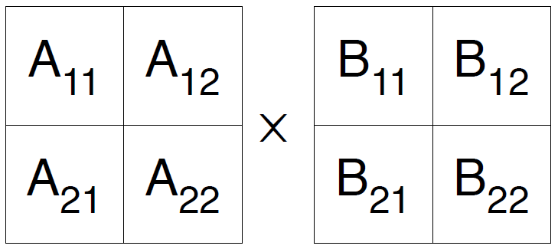
Strassen’s Matrix Multiplication
Strassen’s algorithm for two 2x2 matrices (1969):
c₀₀ c₀₁ a₀₀ a₀₁ b₀₀ b₀₁
= *
c₁₀ c₁₁ a₁₀ a₁₁ b₁₀ b₁₁
m₁ + m₄ - m₅ + m₇ m₃ + m₅
=
m₂ + m₄ m₁ + m₃ - m₂ + m₆
m₁ = (a₀₀ + a₁₁) * (b₀₀ + b₁₁)
m₂ = (a₁₀ + a₁₁) * b₀₀
m₃ = a₀₀ * (b₀₁ - b₁₁)
m₄ = a₁₁ * (b₁₀ - b₀₀)
m₅ = (a₀₀ + a₀₁) * b₁₁
m₆ = (a₁₀ - a₀₀) * (b₀₀ + b₀₁)
m₇ = (a₀₁ - a₁₁) * (b₁₀ + b₁₁)
7 multiplications
18 additions
O (n^2.8)

Slide 36
High Performance Sequential Linear Equation Solver

Slide 39
Gaussian Elimination (GE) for solving Ax=b
Add multiples of each row to later rows to make A upper triangular
Solve resulting triangular system Ux = c by substitution
… for each column i
… zero it out below the diagonal by adding multiples of row i to later rows
for i = 1 to n-1
… for each row j below row i
for j = i+1 to n
… add a multiple of row i to row j
tmp = A(j,i);
for k = i to n
A(j,k) = A(j,k) - (tmp/A(i,i)) * A(i,k)
0
.
.
.
0
0
.
.
.
0
0
.
.
.
0
…
0
.
.
.
0
0
.
.
.
0
0
.
.
.
0
0
.
.
.
0
0
.
0
0
.
0
0
0
0
After i=1
After i=2
After i=3
After i=n-1

Slide 40
Refine GE Algorithm (1)
Initial Version
Remove computation of constant tmp/A(i,i) from inner loop.
… for each column i
… zero it out below the diagonal by adding multiples of row i to later rows
for i = 1 to n-1
… for each row j below row i
for j = i+1 to n
… add a multiple of row i to row j
tmp = A(j,i);
for k = i to n
A(j,k) = A(j,k) - (tmp/A(i,i)) * A(i,k)
for i = 1 to n-1
for j = i+1 to n
m = A(j,i)/A(i,i)
for k = i to n
A(j,k) = A(j,k) - m * A(i,k)
m

Slide 41
Refine GE Algorithm (2)
Last version
Don’t compute what we already know: zeros below diagonal in column i
for i = 1 to n-1
for j = i+1 to n
m = A(j,i)/A(i,i)
for k = i to n
A(j,k) = A(j,k) - m * A(i,k)
for i = 1 to n-1
for j = i+1 to n
m = A(j,i)/A(i,i)
for k = i+1 to n
A(j,k) = A(j,k) - m * A(i,k)
m
Do not compute zeros

Slide 42
Refine GE Algorithm (3)
Last version
Store multipliers m below diagonal in zeroed entries for later use
for i = 1 to n-1
for j = i+1 to n
m = A(j,i)/A(i,i)
for k = i+1 to n
A(j,k) = A(j,k) - m * A(i,k)
for i = 1 to n-1
for j = i+1 to n
A(j,i) = A(j,i)/A(i,i)
for k = i+1 to n
A(j,k) = A(j,k) - A(j,i) * A(i,k)
m
Store m here

Slide 43
Refine GE Algorithm (4)
Last version
for i = 1 to n-1
for j = i+1 to n
A(j,i) = A(j,i)/A(i,i)
for k = i+1 to n
A(j,k) = A(j,k) - A(j,i) * A(i,k)
Split Loop
for i = 1 to n-1
for j = i+1 to n
A(j,i) = A(j,i)/A(i,i)
for j = i+1 to n
for k = i+1 to n
A(j,k) = A(j,k) - A(j,i) * A(i,k)
Store all m’s here before updating rest of matrix

Slide 44
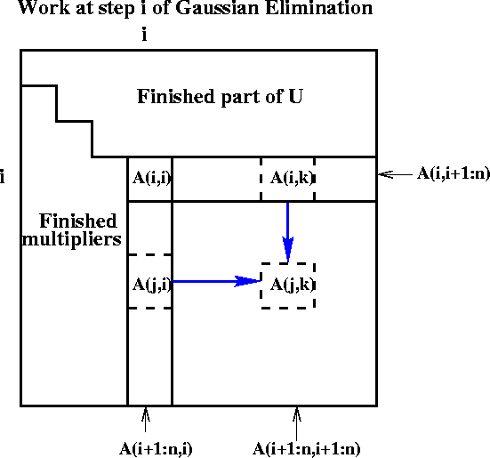
Refine GE Algorithm (5)
for i = 1 to n-1
for j = i+1 to n
A(j,i) = A(j,i)/A(i,i)
for j = i+1 to n
for k = i+1 to n
A(j,k) = A(j,k) - A(j,i) * A(i,k)
Last version
Express using matrix operations (BLAS)
for i = 1 to n-1
A(i+1:n,i) = A(i+1:n,i) * ( 1 / A(i,i) )
A(i+1:n,i+1:n) = A(i+1:n , i+1:n )
- A(i+1:n , i) * A(i , i+1:n)

Slide 45
What GE really computes
Call the strictly lower triangular matrix of multipliers M, and let L = I+M
Call the upper triangle of the final matrix U
Lemma (LU Factorization): If the above algorithm terminates (does not divide by zero) then A = L*U
Solving A*x=b using GE
Factorize A = L*U using GE (cost = 2/3 n³ flops)
Solve L*y = b for y, using substitution (cost = n² flops)
Solve U*x = y for x, using substitution (cost = n² flops)
Thus A*x = (L*U)*x = L*(U*x) = L*y = b as desired
for i = 1 to n-1
A(i+1:n,i) = A(i+1:n,i) / A(i,i)
A(i+1:n,i+1:n) = A(i+1:n , i+1:n ) - A(i+1:n , i) * A(i , i+1:n)

Slide 46
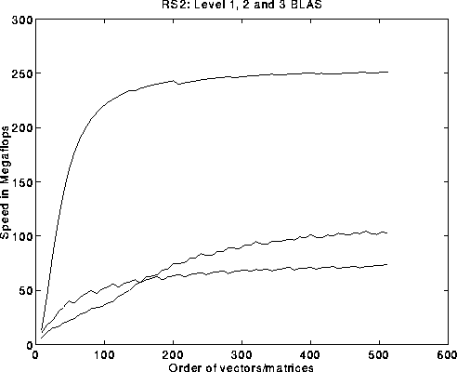
Problems with basic GE algorithm
What if some A(i,i) is zero? Or very small?
Result may not exist, or be “unstable”, so need to pivot
Current computation all BLAS 1 or BLAS 2, but we know that BLAS 3 (matrix multiply) is fastest (earlier lectures…)
for i = 1 to n-1
A(i+1:n,i) = A(i+1:n,i) / A(i,i) … BLAS 1 (scale a vector)
A(i+1:n,i+1:n) = A(i+1:n , i+1:n ) … BLAS 2 (rank-1 update)
- A(i+1:n , i) * A(i , i+1:n)
Peak
BLAS 3
BLAS 2
BLAS 1

Slide 47
Pivoting in Gaussian Elimination
A = [ 0 1 ] fails completely because can’t divide by A(1,1)=0
[ 1 0 ]
But solving Ax=b should be easy!
When diagonal A(i,i) is tiny (not just zero), algorithm may terminate but get completely wrong answer
Numerical instability
Roundoff error is cause
Cure: Pivot (swap rows of A) so A(i,i) large

Slide 48
Gaussian Elimination w/ Partial Pivoting (GEPP)
Partial Pivoting: swap rows so that A(i,i) is largest in column
for i = 1 to n-1
find and record k where |A(k,i)| = max{i <= j <= n} |A(j,i)|
… i.e. largest entry in rest of column i
if |A(k,i)| = 0
exit with a warning that A is singular, or nearly so
elseif k != i
swap rows i and k of A
end if
A(i+1:n,i) = A(i+1:n,i) / A(i,i) … each quotient lies in [-1,1]
A(i+1:n,i+1:n) = A(i+1:n , i+1:n ) - A(i+1:n , i) * A(i , i+1:n)
Lemma: This algorithm computes A = P*L*U, where P is a permutation matrix.
This algorithm is numerically stable in practice
For details see LAPACK code at
http://www.netlib.org/lapack/single/sgetf2.f

Slide 49
Problems with basic GE algorithm
What if some A(i,i) is zero? Or very small?
Result may not exist, or be “unstable”, so need to pivot
Current computation all BLAS 1 or BLAS 2, but we know that BLAS 3 (matrix multiply) is fastest (earlier lectures…)
for i = 1 to n-1
A(i+1:n,i) = A(i+1:n,i) / A(i,i) … BLAS 1 (scale a vector)
A(i+1:n,i+1:n) = A(i+1:n , i+1:n ) … BLAS 2 (rank-1 update)
- A(i+1:n , i) * A(i , i+1:n)
Peak
BLAS 3
BLAS 2
BLAS 1

Slide 50
Converting BLAS2 to BLAS3 in GEPP
Blocking
Used to optimize matrix-multiplication
Harder here because of data dependencies in GEPP
BIG IDEA: Delayed Updates
Save updates to “trailing matrix” from several consecutive BLAS2 updates
Apply many updates simultaneously in one BLAS3 operation
Same idea works for much of dense linear algebra
Open questions remain
First Approach: Need to choose a block size b
Algorithm will save and apply b updates
b must be small enough so that active submatrix consisting of b columns of A fits in cache
b must be large enough to make BLAS3 fast

Slide 51
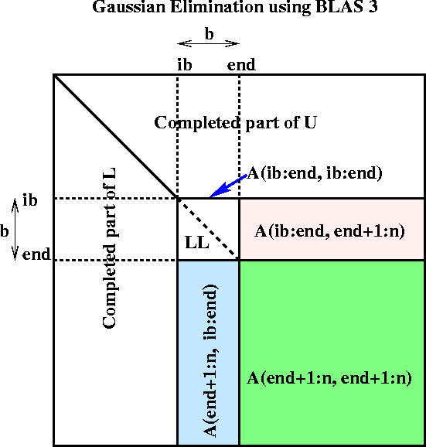
Blocked GEPP (www.netlib.org/lapack/single/sgetrf.f)
for ib = 1 to n-1 step b … Process matrix b columns at a time
end = ib + b-1 … Point to end of block of b columns
apply BLAS2 version of GEPP to get A(ib:n , ib:end) = P’ * L’ * U’
… let LL denote the strict lower triangular part of A(ib:end , ib:end) + I
A(ib:end , end+1:n) = LL⁻¹ * A(ib:end , end+1:n) … update next b rows of U
A(end+1:n , end+1:n ) = A(end+1:n , end+1:n )
- A(end+1:n , ib:end) * A(ib:end , end+1:n)
… apply delayed updates with single matrix-multiply
… with inner dimension b
Notes:
Need to apply row interchanges from A(ib:n, ib:end) to trailing submatrix

